Slide 1
BC1
1
2
3
4
5
6
Disconnect Terminal
8
9
10
11
12
13
14
1.2.1 | Stack.Panel.DI_EmergencyStop
1.2.2 | Stack.Panel.DI_StartButton
1.2.3 | Stack.Panel.DI_ManuelButton
1.2.4 | Crane.Gripper.VacuumSwitch.DI_TakenIn
1.3.1 | Crane.LiftingCylinder.DI_Extended
1.3.2 | Crane.LiftingCylinder.DI_Retracted
1.3.3 | Stack.Seperator.DI_Retracted
1.3.4 | Stack.Seperator.DI_Extended
1.4.1 | Stack.InductiveSensor.DI_WPMetallic
1.4.2 | Stack.OpticalSensor.DI_WPLigh
1.4.3 | Crane.Table.AtStamp.DI_SwitchTrue
1.4.4 | Crane.Table.AtConveyor.DI_SwitchTrue
1.5.1 | Crane.Table.AtStack.DI_SwitchTrue
1.5.2 | Stack.WPAvailable.DI_SwitchTrue
1.5.3 | NO EMERGENCY
1.6.1 | Crane.Gripper.Valve.DO_VacuumOn
1.9.1 | Crane.LiftingCylinder.DO_Extend
1.9.2 | Stack.Seperator.DO_Extend
1.10.1 | Stack.Panel.DO_LampGreen
1.10.2 | Stack.Panel.DO_LampWhite
1.10.3 | Crane.Table.Motor.DO_TurnCounterclockwise
1.10.4 | Crane.Table.Motor.DO_TurnClockwise
1.13.1 | Crane.AI_Positon
1
2
1
2
1
2
1
2
1
2
1
2
1
2
1
2
1
2
1
2
+
+
+
+
+
+
+
+
-
-
-
-
-
-
-
-
+
+
+
+
+
+
+
+
+
+
+
+
-
-
-
-
-
-
-
-
+
+
-
-
3
4
3
4
3
4
3
4
3
4
3
4
3
4
3
4
3
4
S
S
BC1
BK1100
BK1004
BK1004
BK1004
BK1004
EL2004
EL9080
EL9100
EL2004
EL2004
EL2004
BK1004
EL3162
EL9011
free
BIT IN
BIT OUT
Analog IN
Analog OUT
Power

Slide 2
BC2&3
2&3.2.1 | Stamp.Panel.DI_ManuelButton
2&3.2.2 | Stamp.SlidingCylinder.DI_Extended
2&3.2.3 | Stamp.SlidingCylinder.DI_Retracted
2&3.2.4 | Stamp.StampingCylinder.DI_Retracted
2&3.3.1 | Stamp.StampingCylinder.DI_Extended
2&3.3.2 | Stamp.WPAvailable.DI_SwitchTrue
2&3.3.3 | LargeSortingConveyor.Panel.DI_EmergencyStop
2&3.3.4 | LargeSortingConveyor.Panel.DI_StartButton
2&3.4.1 | LargeSortingConveyor.Panel.DI_ManuelButton
2&3.4.2 | LargeSortingConveyor.OptBeginning.DI_WPLight
2&3.4.3 | LargeSortingConveyor.PsBeginning.DI_WPDetected
2&3.4.4 | LargeSortingConveyor.IndRamp1.DI_WPMetallic
2&3.5.1 | LargeSortingConveyor.OptRamp1.DI_WPLight
2&3.5.2 | LargeSortingConveyor.IndRamp2.DI_WPMetallic
2&3.5.4 | LargeSortingConveyor.OptRamp2.DI_WPLight
2&3.5.5 | LargeSortingConveyor.OptEnd.DI_WPLight
2&3.6.1 | LargeSortingConveyor.Seperator1.DI_Extended
2&3.6.2 | LargeSortingConveyor.Seperator1.DI_Retracted
2&3.6.3 | LargeSortingConveyor.Seperator2.DI_Extended
2&3.6.4 | LargeSortingConveyor.Seperator2.DI_Retracted
2&3.7.3 | Stamp.Panel.DI_EmergencyStop
2&3.7.4 | Stamp.Panel.DI_StartButton
2&3.10.1 | Stamp.SlidingCylinder.DO_Extend
2&3.10.2 | Stamp.SlidingCylinder.DO_Retract
2&3.10.3 | Stamp.StampingCylinder.DO_Extend
2&3.10.4 | Stamp.Panel.DO_LampGreen
2&3.11.1 | Stamp.Panel.DO_LampWhite
2&3.11.2 | LargeSortingConveyor.Seperator1.DO_Extend
2&3.11.3 | LargeSortingConveyor.Seperator2.DO_Extend
2&3.11.4 | LargeSortingConveyor.Motor.DO_TurnClockwise
2&3.12.1 | LargeSortingConveyor.Motor.DO_TurnCounterclockwise
2&3.12.2 | LargeSortingConveyor.Panel.DO_LampGreen
2&3.12.3 | LargeSortingConveyor.Panel.DO_LampWhite
2&3.16.1 | Crane.AO_Speed
2&3.16.2 | Stamp.PropValve.AO_SetPressure
2&3.17.1 | LargeSortingConveyor.AO_Speed
1
2
3
4
5
6
7
Disconnect Terminal
9
10
11
12
13
14
15
16
17
18
1
2
1
2
1
2
1
2
1
2
1
2
1
2
1
2
1
2
1
2
1
2
1
2
1
2
+
+
+
+
+
+
+
+
+
+
+
+
-
-
-
-
-
-
-
-
+
+
+
+
+
+
+
+
+
+
+
+
+
+
+
+
-
-
-
-
-
-
-
-
+
+
-
-
G
G
G
G
3
4
3
4
3
4
3
4
3
4
3
4
3
4
3
4
3
4
3
4
3
4
S
S
S
S
BC2&3
EK1100
EL1004
EL1004
EL1004
EL1004
EL1004
EL1004
EL9080
EL9100
EL2004
EL2004
EL2004
EL2004
EL1004
EL9100
EL4102
EL4102
EL9011
free
BIT IN
BIT OUT
Analog IN
Analog OUT
Power

Slide 3
BC4
1
2
3
4
5
6
7
8
9
10
11
12
13
14
15
1
2
1
2
1
2
1
2
1
2
1
2
1
2
1
2
1
2
1
2
1
2
1
2
+
+
+
+
+
+
+
+
+
+
G
G
G
G
G
G
+
+
3
4
-
-
-
-
+
+
+
+
+
+
+
+
+
+
3
4
3
4
3
4
3
4
5
6
-
-
-
-
3
4
3
4
3
4
3
4
3
4
G
G
G
G
G
G
+
+
7
8
3
4
3
4
BC4
EK1100
EL1808
EL1004
EL1004
EL1004
EL1004
EL1004
EL3064
EL3064
EL3164
EL3054
EL3058
EL2004
EL2004
EL9011
4.2.1 | Crane.Table.AtStampInd.DI_InductiveSwitchTrue
4.2.2 | Crane.Table.BetweenConveyorStamp.DI_InductiveSwitchTrue
4.2.3 | Crane.Table.AtStackInd.DI_InductiveSwitchTrue
4.2.4 | Crane.Table.BetweenStackConveyor.DI_InductiveSwitchTrue
4.2.5 | Crane.Table.AtConveyorInd.DI_InductiveSwitchTrue
4.2.6 | LargeSortingConveyor.Ramp1.RampFull.DI_WPDetected
4.2.7 | LargeSortingConveyor.Ramp2.RampFull.DI_WPDetected
4.2.8 | LargeSortingConveyor.Ramp3.RampFull.DI_WPDetected
4.3.1 | Stack.Seperator.DI_BoundaryPressure
4.3.2 | Stamp.SlidingCylinder.DI_BoundaryPressure
4.3.3 | Block_LSCSep1_LSCSep2.DI_BoundaryPressure
4.3.4 | Block_SSC_PAC.DI_BoundaryPressure
4.4.1 | PicAlpha.Gripper.DI_BoundaryVacuumPressure
4.4.2 | PicAlpha.Gripper.DI_BoundaryFlowPressure1
4.4.3 | PicAlpha.Gripper.DI_BoundaryFlowPressure2
4.4.4 | Stamp.StampingCylinder.DI_BoundaryPressure
4.5.1 | SmallSortingConveyor.OptSensor.DI_WPLight
4.5.2 | SmallSortingConveyor.IndSensor.DI_WPMetallic
4.5.3 | SmallSortingConveyor.Ramp.RampFull.DI_WPDetected
4.6.1 | Stamp.StampingCylinder.DI_BoundaryFlowPressure
4.6.4 | Block_Stack_Crane.DI_BoundaryFlowPressure
4.7.2 | Block_LSCSep1_LSCSep2.DI_BoundaryFlowPressure
4.8.1 | Block_Stack_Crane.AI_PressureSensor
4.8.2 | Block_Stamp_RC.AI_PressureSensor
4.8.3 | Block_LSCSep1_LSCSep2.AI_PressureSensor
4.8.4 | PicAlpha.Gripper.AI_VacuumSensor
4.9.1 | LargeSortingConveyor.UltrasonicSensor.AI_UltraSonic
4.9.2 | Stamp.PressureSensor.AI_CurrentPressure
4.9.3 | Block_LSCSep1_LSCSep2.AI_FlowPressure
4.10.1 | EngergyMonitoringHardware.BK_1_6_Wattmeter.AI_Energy
4.10.2 | EngergyMonitoringHardware.BK_2_3_7_Wattmeter.AI_Energy
4.10.3 | EngergyMonitoringHardware.BK_4_5_8_9_10_11_Wattmeter.AI_Energy
4.11.1 | PicAlpha.LiftingCylinder.AI_PressureSensor
4.11.2 | PicAlpha.LiftingCylinder.AI_FlowPressure
4.11.3 | Block_Stamp_RC.AI_FlowPressure
4.11.4 | Block_Stack_Crane.AI_FlowPressure
4.12.1 | Crane.LiftingCylinder.AI_PositionTransmitter
4.12.2 | Stack.Seperator.AI_PositionTransmitter
4.12.3 | Stamp.SlidingCylinder.AI_PositionTransmitter
4.12.4 | Stamp.StampingCylinder.AI_PositionTransmitter
4.12.5 | LargeSortingConveyor.Seperator2.AI_PositionTransmitter
4.12.6 | LargeSortingConveyor.Seperator1.AI_PositionTransmitter
4.12.7 | Crane.Gripper.AI_VacuumPressure
4.13.1 | Block_Stack_Crane.DO_BlockPressure
4.13.3 | Block_Stamp_RC.DO_BlockPressure
4.14.1 | Block_LSCSep1_LSCSep2.DO_BlockPressure
4.14.4 | Block_SSC_PAC.DO_BlockPressure
free
BIT IN
BIT OUT
Analog IN
Analog OUT
Power

Slide 4
BC5
1
2
3
4
5
6
7
8
Disconnect Terminal
5.1.2 | 24 Volt Input
5.1.6 | 24 Volt Input
5.1.7 | 0 Volt Input
5.2.1 | SafetyDoor.Panel.DI_StartButton
5.2.2 | SafetyDoor.Panel.DI_StopButton
5.2.3 | SafetyDoor.Panel.DI_ManuelButton
5.2.4 | SafetyDoor.Panel.DI_ResetButton
5.2.5 | RefillConveyor.PsBegining.DI_WPDetected
5.2.6 | RefillConveyor.PsSwitch.DI_WPDetected
5.2.7 | RefillConveyor.Switch.DI_Retracted
5.2.8 | RefillConveyor.Switch.DI_Extended
5.3.A1 | RefillConveyor.Motor.AI_Position
5.3.B1 | RefillConveyor.Motor.AI_Speed
5.5.3 | 0 Volt Output
5.5.6 | 24 Volt Output
5.5.7 | 0 Volt Output
5.6.1 | SafetyDoor.Panel.DO_LampGreen
5.6.2 | SafetyDoor.Panel.DO_LampReset
5.6.3 | SafetyDoor.Panel.DO_Q1
5.6.4 | SafetyDoor.Panel.DO_Q2
5.6.5 | RefillConveyor.Motor.DO_TurnClockwise
5.6.6 | RefillConveyor.Motor.DO_TurnCounterclockwise
5.6.7 | RefillConveyor.SwitchStopper.DO_Extend
5.7.1 | RefillConveyor.DO_Speed
1
2
A1
B1
1
5
1
2
1
2
3
4
+
+
2
6
3
4
5
6
-
-
3
7
5
6
G
G
7
8
A2
B2
4
8
7
8
S
S
BC5
EK1100
EL1008
EL5152
EL9080
EL9100
EL2008
EL4102
EL9011
free
BIT IN
BIT OUT
Analog IN
Analog OUT
Integer OUT
Power

Slide 5
BC6
1
2
3
4
BC6.2.1 | Stack.AI_WPWeight
BC6.2.3 | GND
BC6.2.7 | GND
BC6.3.1 | Data - Crane.RFID
BC6.3.3 | Data - Crane.RFID
BC6.3.8 | 24 Volt
BC6.3.10 | 0 Volt
1
5
1
2
2
6
+
+
3
7
G
G
4
8
S
S
BC6
EK1100
EL3062
EL6224
EL9011
free
BIT IN
BIT OUT
Analog IN
Analog OUT
Data
Power

Slide 6
BC7
1
2
3
4
5
6
7
BC7.1.6 | 24 Volt Input
BC7.1.7 | 0 Volt Input
BC7.2.3 | LargeSortingConveyor.Switch.DI_Retracted
BC7.2.4 | LargeSortingConveyor.Switch.DI_Extended
BC7.4.6 | 24 Volt Output
BC7.4.7 | 0 Volt Output
BC7.5.3 | LargeSortingConveyor.Switch.DO_Extend
BC7.6.1 | Data - LargeSortingConveyor.RFID
BC7.6.3 | Data - LargeSortingConveyor.RFID
BC7.6.8 | 24 Volt
BC7.6.10 | 0 Volt
Disconnect Terminal
1
2
1
5
1
2
+
+
2
6
-
-
+
+
3
7
-
-
3
4
4
8
3
4
BC7
EK1100
EL1004
EL9080
EL9100
EL2004
EL6224
EK9011
free
BIT IN
BIT OUT
Analog IN
Analog OUT
Data
Power

Slide 7
BC8
1
2
3
4
5
5
6
7
8
9
8.1.2 | 24 Volt Input
8.1.6 | 24 Volt Input
8.1.7 | 0 Volt Input
8.2.1 | PicAlpha.Gripper.DI_TakenIn
8.2.2 | PicAlpha.PicAlpha_OnPickUp1
8.2.3 | PicAlpha.PicAlpha_OnPutDown2
8.2.4 | PicAlpha.PicAlpha_OnPutDown1
8.2.5 | PicAlpha.LiftingCylinder.DI_Extended
8.2.6 | PicAlpha.LiftingCylinder.DI_Retracted
8.2.7 | PicAlpha.PicAlpha_OnPickUp2
8.2.8 | LightGrid.Panel.DI_EmergencyStop
8.3.1 | LightGrid.Panel.DI_StartButton
8.3.2 | LightGrid.ExtendedPanel.DI_StopButton
8.3.3 | LightGrid.Panel.DI_ManuelButton
8.3.4 | LightGrid.Panel.DI_ResetButton
8.5.1 | PicAlpha.Gripper.DO_Intake
8.6.3 | 0 Volt Output
8.6.6 | 24 Volt Output
8.6.7 | 0 Volt Output
8.7.1 | PicAlpha.Motor.DO_Backwards
8.7.2 | PicAlpha.Motor.DO_Forwards
8.7.3 | PicAlpha.LiftingCylinder.DO_Extend
8.7.6 | PicAlpha.DO_VacuumHit
8.8.1 | LightGrid.Panel.DO_LampGreen
8.8.2 | LightGrid.ExtendedPanel.DO_LampReset
8.8.3 | LightGrid.ExtendedPanel.DO_Q1
8.8.4 | LightGrid.ExtendedPanel.DO_Q2
Disconnect Terminal
1
2
1
2
1
2
1
2
1
5
1
2
1
2
3
4
+
+
-
+
-
-
2
6
3
4
-
-
5
6
+
+
G
G
-
-
3
7
5
6
-
-
7
8
3
4
S
S
3
4
4
8
7
8
3
4
BC8
EK1100
EL1008
EL1004
EL3062
EL2004
EL9080
EL9100
EL2008
EL2004
EL9011
free
BIT IN
BIT OUT
Analog IN
Analog OUT
Power

Slide 8
BC9
1
2
3
4
5
6
7
8
Disconnect Terminal
9.1.6 | 24 Volt Input
9.1.7 | 0 Volt Input
9.2.1 | PicAlphaConveyor.PsSwitch.DI_WPDetected
9.2.2 | PicAlphaConveyor.PsEnd.DI_WPDetected
9.2.3 | PicAlphaConveyor.Switch.DI_Retracted
9.2.4 | PicAlphaConveyor.Switch.DI_Extended
9.3.A1 | PicAlphaConveyor.Motor.AI_Position
9.3.B1 | PicAlphaConveyor.Motor.AI_Speed
9.5.6 | 24 Volt Output
9.5.7 | 0 Volt Output
9.6.1 | PicAlphaConveyor.Motor.DO_TurnClockwise
9.6.2 | PicAlphaConveyor.Motor.DO_TurnCounterclockwise
9.6.3 | PicAlphaConveyor.Switch.DO_Extend
9.7.1 | PicAlphaConveyor.AO_Speed
1
2
A1
B1
1
5
1
2
1
2
+
+
+
+
2
6
-
-
+
+
-
-
3
7
-
-
G
G
3
4
A2
B2
4
8
3
4
S
S
BC9
EK1100
EL1004
EL5152
EL9080
EL9100
EL2004
EL4102
EL9011
free
BIT IN
BIT OUT
Analog IN
Analog OUT
Integer OUT
Power

Slide 9
BC10
1
2
3
4
5
6
7
8
10.1.6 | 24 Volt Input
10.1.7 | 0 Volt Input
10.2.1 | SmallSortingConveyor.DI_Beginning_PresenceSensor
10.2.2 | SmallSortingConveyor.DI_End_PresenceSensor
10.2.3 | SmallSortingConveyor.Switch.DI_Retracted
10.2.4 | SmallSortingConveyor.Switch.DI_Extanded
10.3.A1 | SmallSorringConveyor.Motor.AI_Position
10.3.B1 | SmallSorringConveyor.Motor.AI_Speed
10.5.6 | 24 Volt Output
10.5.7 | 0 Volt Output
10.6.1 | SmallSortingConveyor.Motor.DO_TurnClockwise
10.6.2 | SmallSortingConveyor.Motor.DO_TurnCounterclockwise
10.6.3 | SmallSortingConveyor.Switch.DO_Extend
10.7.1 | SmallSortingConveyor.AO_Speed
Disconnect Terminal
1
2
A1
B1
1
5
1
2
1
2
+
+
+
+
2
6
-
-
+
+
-
-
3
7
-
-
G
G
3
4
A2
B2
4
8
3
4
S
S
BC10
EK1100
EL1004
EL5152
EL9080
EL9100
EL2004
EL4102
EL9011
free
BIT IN
BIT OUT
Analog IN
Analog OUT
Integer OUT
Power

Slide 10
BC11
1
2
3
4
5
6
7
11.1.6 | 24 Volt Input
11.1.7 | 0 Volt Input
11.2.1 | EngergyMonitoringHardware.GearPoint_80l_min.DI_ReachedGearPoint
11.2.2 | EngergyMonitoringHardware.GearPoint_120l_min.DI_ReachedGearPoint
11.2.3 | EngergyMonitoringHardware.PressureSensor_4bar.DI_PressureReached
11.3.1 | EngergyMonitoringHardware.Flow_2to200l_min.AI_Flow
11.3.2 | EngergyMonitoringHardware.Transducer_0to10AC_0to10V.AI_AmperToVolt
11.3.3 | EngergyMonitoringHardware.ExtSensor_0to10V.AI_Voltage
11.3.4 | PressurSensor
11.3.G(8) | 0 Volt GND
11.5.6 | 0 Volt GND
11.5.7 | 24 Volt Output
11.6.1 | 0 Volt Output
11.6.2 | EngergyMonitoringHardware.SmallContacter_left.DO_Plug
11.6.3 | EngergyMonitoringHardware.SmallContacter_right.DO_Plug
11.1.6 | EngergyMonitoringHardware.ChangeoverMagnetVaveRelay.DO_Changeover
Disconnect Terminal
1
2
1
2
1
5
1
2
+
+
G
G
2
6
-
-
+
+
3
4
3
7
-
-
3
4
G
G
4
8
3
4
BC11
EK1100
EL1004
EL3064
EL9080
EL9100
EL2004
EL9011
free
BIT IN
BIT OUT
Analog IN
Analog OUT
Power

Slide 11
free
Clamps Scenario 0-1
BIT IN
BIT OUT
1
2
3
4
5
6
9
10
11
12
13
14
Analog IN
Analog OUT
Integer OUT
1
2
1
2
1
2
1
2
1
2
1
2
1
2
1
2
1
2
1
2
Data
+
+
+
+
+
+
+
+
-
-
-
-
-
-
-
-
+
+
+
+
Power
+
+
+
+
+
+
+
+
-
-
-
-
-
-
-
-
+
+
-
-
3
4
3
4
3
4
3
4
3
4
3
4
3
4
3
4
3
4
S
S
BC1
BK1100
BK1004
BK1004
BK1004
BK1004
EL2004
EL2004
EL2004
EL2004
BK1004
EL3162
EL9011

Slide 12
free
Clamps Scenario 2
BIT IN
BIT OUT
1
2
3
4
5
6
9
10
11
12
13
14
Analog IN
Analog OUT
Integer OUT
1
2
1
2
1
2
1
2
1
2
1
2
1
2
1
2
1
2
1
2
Data
+
+
+
+
+
+
+
+
-
-
-
-
-
-
-
-
+
+
+
+
Power
+
+
+
+
+
+
+
+
-
-
-
-
-
-
-
-
+
+
-
-
3
4
3
4
3
4
3
4
3
4
3
4
3
4
3
4
3
4
S
S
BC1
BK1100
BK1004
BK1004
BK1004
BK1004
EL2004
EL2004
EL2004
EL2004
BK1004
EL3162
EL9011

Slide 13
free
Clamps Scenario 3
BIT IN
BIT OUT
1
2
3
4
5
6
9
10
11
12
13
14
1
2
3
7
10
11
13
14
15
16
17
18
Analog IN
Analog OUT
Integer OUT
1
2
1
2
1
2
1
2
1
2
1
2
1
2
1
2
1
2
1
2
1
2
1
2
1
2
1
2
1
2
1
2
1
2
1
2
1
2
Data
+
+
+
+
+
+
+
+
-
-
-
-
-
-
-
-
+
+
+
+
+
+
+
+
+
+
-
-
-
-
-
-
+
+
+
+
Power
+
+
+
+
+
+
+
+
-
-
-
-
-
-
-
-
+
+
-
-
+
+
+
+
+
+
-
-
-
-
-
-
+
+
-
-
G
G
G
G
3
4
3
4
3
4
3
4
3
4
3
4
3
4
3
4
3
4
S
S
3
4
3
4
3
4
3
4
3
4
3
4
3
4
S
S
S
S
BC1
BK1100
BK1004
BK1004
BK1004
BK1004
EL2004
EL2004
EL2004
EL2004
BK1004
EL3162
EL9011
BC2&3
EK1100
EL1004
EL1004
EL1004
EL2004
EL2004
EL2004
EL1004
EL9100
EL4102
EL4102
EL9011

Slide 14
free
Clamps Scenario 4a-6
BIT IN
BIT OUT
1
2
3
4
5
6
9
10
11
12
13
14
1
2
3
7
10
11
13
14
15
16
17
18
Analog IN
Analog OUT
Integer OUT
1
2
1
2
1
2
1
2
1
2
1
2
1
2
1
2
1
2
1
2
1
2
1
2
1
2
1
2
1
2
1
2
1
2
1
2
1
2
Data
+
+
+
+
+
+
+
+
-
-
-
-
-
-
-
-
+
+
+
+
+
+
+
+
+
+
-
-
-
-
-
-
+
+
+
+
Power
+
+
+
+
+
+
+
+
-
-
-
-
-
-
-
-
+
+
-
-
+
+
+
+
+
+
-
-
-
-
-
-
+
+
-
-
G
G
G
G
3
4
3
4
3
4
3
4
3
4
3
4
3
4
3
4
3
4
S
S
3
4
3
4
3
4
3
4
3
4
3
4
3
4
S
S
S
S
BC1
BK1100
BK1004
BK1004
BK1004
BK1004
EL2004
EL2004
EL2004
EL2004
BK1004
EL3162
EL9011
BC2&3
EK1100
EL1004
EL1004
EL1004
EL2004
EL2004
EL2004
EL1004
EL9100
EL4102
EL4102
EL9011
1
2
15
BC4
EK1100
EL1808
EL9011

Slide 15
free
Clamps Scenario 7-8
BIT IN
BIT OUT
1
2
3
4
5
6
9
10
11
12
13
14
1
2
3
7
10
11
13
14
15
16
17
18
Analog IN
Analog OUT
Integer OUT
1
2
1
2
1
2
1
2
1
2
1
2
1
2
1
2
1
2
1
2
1
2
1
2
1
2
1
2
1
2
1
2
1
2
1
2
1
2
Data
+
+
+
+
+
+
+
+
-
-
-
-
-
-
-
-
+
+
+
+
+
+
+
+
+
+
-
-
-
-
-
-
+
+
+
+
Power
+
+
+
+
+
+
+
+
-
-
-
-
-
-
-
-
+
+
-
-
+
+
+
+
+
+
-
-
-
-
-
-
+
+
-
-
G
G
G
G
3
4
3
4
3
4
3
4
3
4
3
4
3
4
3
4
3
4
S
S
3
4
3
4
3
4
3
4
3
4
3
4
3
4
S
S
S
S
BC1
BK1100
BK1004
BK1004
BK1004
BK1004
EL2004
EL2004
EL2004
EL2004
BK1004
EL3162
EL9011
BC2&3
EK1100
EL1004
EL1004
EL1004
EL2004
EL2004
EL2004
EL1004
EL9100
EL4102
EL4102
EL9011
1
2
15
BC4
EK1100
EL1808
EL9011

Slide 16
free
Clamps Scenario 9
BIT IN
BIT OUT
1
2
3
4
5
6
9
10
11
12
13
14
1
2
3
4
7
10
11
12
13
14
15
16
17
18
Analog IN
Analog OUT
Integer OUT
1
2
1
2
1
2
1
2
1
2
1
2
1
2
1
2
1
2
1
2
1
2
1
2
1
2
1
2
1
2
1
2
1
2
1
2
1
2
1
2
1
2
Data
+
+
+
+
+
+
+
+
-
-
-
-
-
-
-
-
+
+
+
+
+
+
+
+
+
+
+
+
-
-
-
-
-
-
-
-
+
+
+
+
Power
+
+
+
+
+
+
+
+
-
-
-
-
-
-
-
-
+
+
-
-
+
+
+
+
+
+
+
+
-
-
-
-
-
-
-
-
+
+
-
-
G
G
G
G
3
4
3
4
3
4
3
4
3
4
3
4
3
4
3
4
3
4
S
S
3
4
3
4
3
4
3
4
3
4
3
4
3
4
3
4
3
4
S
S
S
S
BC1
BK1100
BK1004
BK1004
BK1004
BK1004
EL2004
EL2004
EL2004
EL2004
BK1004
EL3162
EL9011
BC2&3
EK1100
EL1004
EL1004
EL1004
EL1004
EL2004
EL2004
EL2004
EL2004
EL1004
EL9100
EL4102
EL4102
EL9011
1
2
15
BC4
EK1100
EL1808
EL9011

Slide 17
free
Clamps Scenario 10
BIT IN
BIT OUT
1
2
3
4
5
6
9
10
11
12
13
14
1
2
3
4
5
6
7
10
11
12
13
14
15
16
17
18
Analog IN
Analog OUT
Integer OUT
1
2
1
2
1
2
1
2
1
2
1
2
1
2
1
2
1
2
1
2
1
2
1
2
1
2
1
2
1
2
1
2
1
2
1
2
1
2
1
2
1
2
1
2
1
2
Data
+
+
+
+
+
+
+
+
-
-
-
-
-
-
-
-
+
+
+
+
+
+
+
+
+
+
+
+
+
+
+
+
-
-
-
-
-
-
-
-
+
+
+
+
Power
+
+
+
+
+
+
+
+
-
-
-
-
-
-
-
-
+
+
-
-
+
+
+
+
+
+
+
+
+
+
+
+
-
-
-
-
-
-
-
-
+
+
-
-
G
G
G
G
3
4
3
4
3
4
3
4
3
4
3
4
3
4
3
4
3
4
S
S
3
4
3
4
3
4
3
4
3
4
3
4
3
4
3
4
3
4
3
4
3
4
S
S
S
S
BC1
BK1100
BK1004
BK1004
BK1004
BK1004
EL2004
EL2004
EL2004
EL2004
BK1004
EL3162
EL9011
BC2&3
EK1100
EL1004
EL1004
EL1004
EL1004
EL1004
EL1004
EL2004
EL2004
EL2004
EL2004
EL1004
EL9100
EL4102
EL4102
EL9011
1
2
15
BC4
EK1100
EL1808
EL9011

Slide 18
free
Clamps Scenario 11-12
BIT IN
BIT OUT
1
2
3
4
5
6
9
10
11
12
13
14
1
2
3
4
5
6
7
10
11
12
13
14
15
16
17
18
Analog IN
Analog OUT
Integer OUT
1
2
1
2
1
2
1
2
1
2
1
2
1
2
1
2
1
2
1
2
1
2
1
2
1
2
1
2
1
2
1
2
1
2
1
2
1
2
1
2
1
2
1
2
1
2
Data
+
+
+
+
+
+
+
+
-
-
-
-
-
-
-
-
+
+
+
+
+
+
+
+
+
+
+
+
+
+
+
+
-
-
-
-
-
-
-
-
+
+
+
+
Power
+
+
+
+
+
+
+
+
-
-
-
-
-
-
-
-
+
+
-
-
+
+
+
+
+
+
+
+
+
+
+
+
-
-
-
-
-
-
-
-
+
+
-
-
G
G
G
G
3
4
3
4
3
4
3
4
3
4
3
4
3
4
3
4
3
4
S
S
3
4
3
4
3
4
3
4
3
4
3
4
3
4
3
4
3
4
3
4
3
4
S
S
S
S
BC1
BK1100
BK1004
BK1004
BK1004
BK1004
EL2004
EL2004
EL2004
EL2004
BK1004
EL3162
EL9011
BC2&3
EK1100
EL1004
EL1004
EL1004
EL1004
EL1004
EL1004
EL2004
EL2004
EL2004
EL2004
EL1004
EL9100
EL4102
EL4102
EL9011
1
2
15
BC4
EK1100
EL1808
EL9011

Slide 19
free
Clamps Scenario 12f
BIT IN
BIT OUT
1
2
3
4
5
6
9
10
11
12
13
14
1
2
3
4
5
6
7
10
11
12
13
14
15
16
17
18
Analog IN
Analog OUT
Integer OUT
1
2
1
2
1
2
1
2
1
2
1
2
1
2
1
2
1
2
1
2
1
2
1
2
1
2
1
2
1
2
1
2
1
2
1
2
1
2
1
2
1
2
1
2
1
2
Data
+
+
+
+
+
+
+
+
-
-
-
-
-
-
-
-
+
+
+
+
+
+
+
+
+
+
+
+
+
+
+
+
-
-
-
-
-
-
-
-
+
+
+
+
Power
+
+
+
+
+
+
+
+
-
-
-
-
-
-
-
-
+
+
-
-
+
+
+
+
+
+
+
+
+
+
+
+
-
-
-
-
-
-
-
-
+
+
-
-
G
G
G
G
3
4
3
4
3
4
3
4
3
4
3
4
3
4
3
4
3
4
S
S
3
4
3
4
3
4
3
4
3
4
3
4
3
4
3
4
3
4
3
4
3
4
S
S
S
S
BC1
BK1100
BK1004
BK1004
BK1004
BK1004
EL2004
EL2004
EL2004
EL2004
BK1004
EL3162
EL9011
BC2&3
EK1100
EL1004
EL1004
EL1004
EL1004
EL1004
EL1004
EL2004
EL2004
EL2004
EL2004
EL1004
EL9100
EL4102
EL4102
EL9011
1
2
3
4
6
7
8
9
11
12
13
14
15
1
2
1
2
1
2
1
2
1
2
1
2
1
2
1
2
1
2
1
2
+
+
+
+
+
+
+
+
G
G
G
G
+
+
3
4
-
-
-
-
+
+
+
+
+
+
+
+
3
4
3
4
3
4
5
6
-
-
-
-
3
4
3
4
3
4
3
4
G
G
G
G
+
+
7
8
3
4
3
4
BC4
EK1100
EL1808
EL1004
EL1004
EL1004
EL1004
EL3064
EL3064
EL3054
EL3058
EL2004
EL2004
EL9011

Slide 20
free
Clamps Scenario 13
BIT IN
BIT OUT
1
2
3
4
5
6
9
10
11
12
13
14
1
2
3
4
5
6
7
10
11
12
13
14
15
16
17
18
Analog IN
Analog OUT
Integer OUT
1
2
1
2
1
2
1
2
1
2
1
2
1
2
1
2
1
2
1
2
1
2
1
2
1
2
1
2
1
2
1
2
1
2
1
2
1
2
1
2
1
2
1
2
1
2
Data
2
Power
+
+
+
+
+
+
+
+
-
-
-
-
-
-
-
-
+
+
+
+
+
+
+
+
+
+
+
+
+
+
+
+
-
-
-
-
-
-
-
-
+
+
+
+
+
+
+
+
+
+
+
+
-
-
-
-
-
-
-
-
+
+
-
-
+
+
+
+
+
+
+
+
+
+
+
+
-
-
-
-
-
-
-
-
+
+
-
-
G
G
G
G
3
4
3
4
3
4
3
4
3
4
3
4
3
4
3
4
3
4
S
S
3
4
3
4
3
4
3
4
3
4
3
4
3
4
3
4
3
4
3
4
3
4
S
S
S
S
BC1
BK1100
BK1004
BK1004
BK1004
BK1004
EL2004
EL2004
EL2004
EL2004
BK1004
EL3162
EL9011
BC2&3
EK1100
EL1004
EL1004
EL1004
EL1004
EL1004
EL1004
EL2004
EL2004
EL2004
EL2004
EL1004
EL9100
EL4102
EL4102
EL9011
1
2
3
4
6
7
8
9
11
12
13
14
15
1
2
1
2
1
2
1
2
1
2
1
2
1
2
1
2
1
2
1
2
+
+
+
+
+
+
+
+
G
G
G
G
+
+
3
4
-
-
-
-
+
+
+
+
+
+
+
+
3
4
3
4
3
4
5
6
-
-
-
-
3
4
3
4
3
4
3
4
G
G
G
G
+
+
7
8
3
4
3
4
BC4
EK1100
EL1808
EL1004
EL1004
EL1004
EL1004
EL3064
EL3064
EL3054
EL3058
EL2004
EL2004
EL9011

Slide 21
free
Clamps Scenario 14
BIT IN
BIT OUT
1
2
3
4
5
6
9
10
11
12
13
14
1
2
3
4
5
6
7
10
11
12
13
14
15
16
17
18
Analog IN
Analog OUT
Integer OUT
1
2
1
2
1
2
1
2
1
2
1
2
1
2
1
2
1
2
1
2
1
2
1
2
1
2
1
2
1
2
1
2
1
2
1
2
1
2
1
2
1
2
1
2
1
2
Data
+
+
+
+
+
+
+
+
-
-
-
-
-
-
-
-
+
+
+
+
+
+
+
+
+
+
+
+
+
+
+
+
-
-
-
-
-
-
-
-
+
+
+
+
Power
+
+
+
+
+
+
+
+
-
-
-
-
-
-
-
-
+
+
-
-
+
+
+
+
+
+
+
+
+
+
+
+
-
-
-
-
-
-
-
-
+
+
-
-
G
G
G
G
3
4
3
4
3
4
3
4
3
4
3
4
3
4
3
4
3
4
S
S
3
4
3
4
3
4
3
4
3
4
3
4
3
4
3
4
3
4
3
4
3
4
S
S
S
S
BC1
BK1100
BK1004
BK1004
BK1004
BK1004
EL2004
EL2004
EL2004
EL2004
BK1004
EL3162
EL9011
BC2&3
EK1100
EL1004
EL1004
EL1004
EL1004
EL1004
EL1004
EL2004
EL2004
EL2004
EL2004
EL1004
EL9100
EL4102
EL4102
EL9011
1
2
3
4
6
7
8
9
11
12
13
14
15
1
2
4
1
2
1
2
1
2
1
2
1
2
1
2
1
2
1
2
1
2
1
2
1
5
1
2
+
+
+
+
+
+
+
+
G
G
G
G
+
+
3
4
-
-
-
-
2
6
+
+
+
+
+
+
+
+
+
+
3
4
3
4
3
4
5
6
-
-
-
-
3
7
G
G
3
4
3
4
3
4
3
4
G
G
G
G
+
+
7
8
3
4
3
4
4
8
S
S
BC4
EK1100
EL1808
EL1004
EL1004
EL1004
EL1004
EL3064
EL3064
EL3054
EL3058
EL2004
EL2004
EL9011
BC6
EK1100
EL3062
EL9011

Slide 22
free
Clamps Scenario 15
BIT IN
BIT OUT
1
2
3
4
5
6
9
10
11
12
13
14
1
2
3
4
5
6
7
10
11
12
13
14
15
16
17
18
Analog IN
Analog OUT
Integer OUT
1
2
1
2
1
2
1
2
1
2
1
2
1
2
1
2
1
2
1
2
1
2
1
2
1
2
1
2
1
2
1
2
1
2
1
2
1
2
1
2
1
2
1
2
1
2
Data
+
+
+
+
+
+
+
+
-
-
-
-
-
-
-
-
+
+
+
+
+
+
+
+
+
+
+
+
+
+
+
+
-
-
-
-
-
-
-
-
+
+
+
+
Power
+
+
+
+
+
+
+
+
-
-
-
-
-
-
-
-
+
+
-
-
+
+
+
+
+
+
+
+
+
+
+
+
-
-
-
-
-
-
-
-
+
+
-
-
G
G
G
G
3
4
3
4
3
4
3
4
3
4
3
4
3
4
3
4
3
4
S
S
3
4
3
4
3
4
3
4
3
4
3
4
3
4
3
4
3
4
3
4
3
4
S
S
S
S
BC1
BK1100
BK1004
BK1004
BK1004
BK1004
EL2004
EL2004
EL2004
EL2004
BK1004
EL3162
EL9011
BC2&3
EK1100
EL1004
EL1004
EL1004
EL1004
EL1004
EL1004
EL2004
EL2004
EL2004
EL2004
EL1004
EL9100
EL4102
EL4102
EL9011
1
2
3
4
5
6
7
8
9
11
12
13
14
15
1
2
3
6
7
8
1
2
4
1
2
5
7
1
2
1
2
1
2
1
2
1
2
1
2
1
2
1
2
1
2
1
2
1
2
1
2
A1
B1
1
2
1
2
1
5
1
2
1
2
1
2
+
+
+
+
+
+
+
+
+
+
G
G
G
G
+
+
3
4
-
-
-
-
3
4
+
+
3
4
2
6
+
+
+
+
-
-
+
+
+
+
+
+
+
+
+
+
3
4
3
4
3
4
5
6
-
-
-
-
5
6
-
-
5
6
G
G
3
7
G
G
+
+
-
-
3
4
3
4
3
4
3
4
3
4
G
G
G
G
+
+
7
8
3
4
3
4
7
8
A2
B2
7
8
S
S
4
8
S
S
3
4
3
4
BC4
EK1100
EL1808
EL1004
EL1004
EL1004
EL1004
EL1004
EL3064
EL3064
EL3054
EL3058
EL2004
EL2004
EL9011
BC5
EK1100
EL1008
EL5152
EL2008
EL4102
EL9011
BC6
EK1100
EL3062
EL9011
BC7
EK1100
EL1004
EL2004
EK9011
1
2
3
6
7
8
1
2
3
6
7
8
1
2
A1
B1
1
2
1
2
1
2
A1
B1
1
2
1
2
+
+
+
+
-
-
+
+
+
+
-
-
+
+
-
-
-
-
G
G
+
+
-
-
-
-
G
G
3
4
A2
B2
3
4
S
S
3
4
A2
B2
3
4
S
S
BC9
EK1100
EL1004
EL5152
EL2004
EL4102
EL9011
BC10
EK1100
EL1004
EL5152
EL2004
EL4102
EL9011

Slide 23
free
Clamps Scenario 16
BIT IN
BIT OUT
1
2
3
4
5
6
9
10
11
12
13
14
1
2
3
4
5
6
7
10
11
12
13
14
15
16
17
18
Analog IN
Analog OUT
Integer OUT
1
2
1
2
1
2
1
2
1
2
1
2
1
2
1
2
1
2
1
2
1
2
1
2
1
2
1
2
1
2
1
2
1
2
1
2
1
2
1
2
1
2
1
2
1
2
Data
+
+
+
+
+
+
+
+
-
-
-
-
-
-
-
-
+
+
+
+
+
+
+
+
+
+
+
+
+
+
+
+
-
-
-
-
-
-
-
-
+
+
+
+
Power
+
+
+
+
+
+
+
+
-
-
-
-
-
-
-
-
+
+
-
-
+
+
+
+
+
+
+
+
+
+
+
+
-
-
-
-
-
-
-
-
+
+
-
-
G
G
G
G
3
4
3
4
3
4
3
4
3
4
3
4
3
4
3
4
3
4
S
S
3
4
3
4
3
4
3
4
3
4
3
4
3
4
3
4
3
4
3
4
3
4
S
S
S
S
BC1
BK1100
BK1004
BK1004
BK1004
BK1004
EL2004
EL2004
EL2004
EL2004
BK1004
EL3162
EL9011
BC2&3
EK1100
EL1004
EL1004
EL1004
EL1004
EL1004
EL1004
EL2004
EL2004
EL2004
EL2004
EL1004
EL9100
EL4102
EL4102
EL9011
1
2
3
4
5
6
7
8
9
11
12
13
14
15
1
2
3
6
7
8
1
2
4
1
2
5
7
1
2
1
2
1
2
1
2
1
2
1
2
1
2
1
2
1
2
1
2
1
2
1
2
A1
B1
1
2
1
2
1
5
1
2
1
2
1
2
+
+
+
+
+
+
+
+
+
+
G
G
G
G
+
+
3
4
-
-
-
-
3
4
+
+
3
4
2
6
+
+
+
+
-
-
+
+
+
+
+
+
+
+
+
+
3
4
3
4
3
4
5
6
-
-
-
-
5
6
-
-
5
6
G
G
3
7
G
G
+
+
-
-
3
4
3
4
3
4
3
4
3
4
G
G
G
G
+
+
7
8
3
4
3
4
7
8
A2
B2
7
8
S
S
4
8
S
S
3
4
3
4
BC4
EK1100
EL1808
EL1004
EL1004
EL1004
EL1004
EL1004
EL3064
EL3064
EL3054
EL3058
EL2004
EL2004
EL9011
BC5
EK1100
EL1008
EL5152
EL2008
EL4102
EL9011
BC6
EK1100
EL3062
EL9011
BC7
EK1100
EL1004
EL2004
EK9011
1
2
4
1
2
3
6
7
8
1
2
3
6
7
8
1
2
1
2
1
2
1
2
A1
B1
1
2
1
2
1
2
A1
B1
1
2
1
2
3
4
-
+
3
4
+
+
+
+
-
-
+
+
+
+
-
-
5
6
G
G
5
6
+
+
-
-
-
-
G
G
+
+
-
-
-
-
G
G
7
8
S
S
7
8
3
4
A2
B2
3
4
S
S
3
4
A2
B2
3
4
S
S
EK1100
EL1008
EL3062
BC9
EK1100
EL1004
EL5152
EL2004
EL4102
EL9011
BC10
EK1100
EL1004
EL5152
EL2004
EL4102
EL9011

Slide 24
free
Clamps Scenario 16f
BIT IN
BIT OUT
1
2
3
4
5
6
9
10
11
12
13
14
1
2
3
4
5
6
7
10
11
12
13
14
15
16
17
18
Analog IN
Analog OUT
Integer OUT
1
2
1
2
1
2
1
2
1
2
1
2
1
2
1
2
1
2
1
2
1
2
1
2
1
2
1
2
1
2
1
2
1
2
1
2
1
2
1
2
1
2
1
2
1
2
Data
+
+
+
+
+
+
+
+
-
-
-
-
-
-
-
-
+
+
+
+
+
+
+
+
+
+
+
+
+
+
+
+
-
-
-
-
-
-
-
-
+
+
+
+
Power
+
+
+
+
+
+
+
+
-
-
-
-
-
-
-
-
+
+
-
-
+
+
+
+
+
+
+
+
+
+
+
+
-
-
-
-
-
-
-
-
+
+
-
-
G
G
G
G
3
4
3
4
3
4
3
4
3
4
3
4
3
4
3
4
3
4
S
S
3
4
3
4
3
4
3
4
3
4
3
4
3
4
3
4
3
4
3
4
3
4
S
S
S
S
BC1
BK1100
BK1004
BK1004
BK1004
BK1004
EL2004
EL2004
EL2004
EL2004
BK1004
EL3162
EL9011
BC2&3
EK1100
EL1004
EL1004
EL1004
EL1004
EL1004
EL1004
EL2004
EL2004
EL2004
EL2004
EL1004
EL9100
EL4102
EL4102
EL9011
1
2
3
4
5
6
7
8
9
11
12
13
14
15
1
2
3
6
7
8
1
2
4
1
2
5
7
1
2
1
2
1
2
1
2
1
2
1
2
1
2
1
2
1
2
1
2
1
2
1
2
A1
B1
1
2
1
2
1
5
1
2
1
2
1
2
+
+
+
+
+
+
+
+
+
+
G
G
G
G
+
+
3
4
-
-
-
-
3
4
+
+
3
4
2
6
+
+
+
+
-
-
+
+
+
+
+
+
+
+
+
+
3
4
3
4
3
4
5
6
-
-
-
-
5
6
-
-
5
6
G
G
3
7
G
G
+
+
-
-
3
4
3
4
3
4
3
4
3
4
G
G
G
G
+
+
7
8
3
4
3
4
7
8
A2
B2
7
8
S
S
4
8
S
S
3
4
3
4
BC4
EK1100
EL1808
EL1004
EL1004
EL1004
EL1004
EL1004
EL3064
EL3064
EL3054
EL3058
EL2004
EL2004
EL9011
BC5
EK1100
EL1008
EL5152
EL2008
EL4102
EL9011
BC6
EK1100
EL3062
EL9011
BC7
EK1100
EL1004
EL2004
EK9011
1
2
4
1
2
3
6
7
8
1
2
3
6
7
8
1
2
1
2
1
2
1
2
A1
B1
1
2
1
2
1
2
A1
B1
1
2
1
2
3
4
-
+
3
4
+
+
+
+
-
-
+
+
+
+
-
-
5
6
G
G
5
6
+
+
-
-
-
-
G
G
+
+
-
-
-
-
G
G
7
8
S
S
7
8
3
4
A2
B2
3
4
S
S
3
4
A2
B2
3
4
S
S
EK1100
EL1008
EL3062
BC9
EK1100
EL1004
EL5152
EL2004
EL4102
EL9011
BC10
EK1100
EL1004
EL5152
EL2004
EL4102
EL9011

Slide 25
free
Clamps Scenario 17
BIT IN
BIT OUT
1
3
4
5
8
9
10
1
2
3
4
5
6
7
9
10
11
12
13
14
15
16
17
18
Analog IN
Disconnect Terminal
Analog OUT
Integer OUT
1
2
1
2
1
2
1
2
1
2
1
2
1
2
1
2
1
2
1
2
1
2
1
2
1
2
1
2
1
2
1
2
1
2
1
2
Data
+
+
+
+
+
+
-
-
-
-
+
+
+
+
+
+
+
+
+
+
+
+
-
-
-
-
-
-
-
-
+
+
+
+
Power
+
+
+
+
+
+
-
-
-
-
+
+
+
+
+
+
+
+
+
+
+
+
-
-
-
-
-
-
-
-
+
+
-
-
G
G
G
G
3
4
3
4
3
4
3
4
3
4
3
4
3
4
3
4
3
4
3
4
3
4
3
4
3
4
3
4
3
4
3
4
S
S
S
S
BK1100
BK1004
BK1004
BK1004
EL9100
EL2004
EL2004
BC2&3
EK1100
EL1004
EL1004
EL1004
EL1004
EL1004
EL1004
EL9080
EL9100
EL2004
EL2004
EL2004
EL2004
EL1004
EL9100
EL4102
EL4102
EL9011
1
3
4
5
6
7
8
9
11
12
13
14
15
1
2
3
4
5
6
7
8
1
2
1
2
3
4
5
7
2
Disconnect Terminal
4
Disconnect Terminal
1
2
1
2
1
2
1
2
1
2
1
2
1
2
1
2
1
2
1
2
1
2
1
2
A1
B1
1
5
1
2
1
2
1
5
1
2
1
2
1
5
1
2
+
+
+
+
+
+
+
+
+
+
G
G
G
G
+
+
3
4
-
-
-
-
3
4
+
+
2
6
3
4
2
6
+
+
+
+
2
6
-
-
+
+
+
+
+
+
+
+
+
+
3
4
3
4
3
4
5
6
-
-
-
-
5
6
-
-
3
7
5
6
G
G
3
7
G
G
+
+
3
7
-
-
3
4
3
4
3
4
3
4
3
4
G
G
G
G
+
+
7
8
3
4
3
4
7
8
A2
B2
4
8
7
8
S
S
4
8
S
S
3
4
4
8
3
4
BC4
EK1100
EL1808
EL1004
EL1004
EL1004
EL1004
EL1004
EL3064
EL3064
EL3054
EL3058
EL2004
EL2004
EL9011
BC5
EK1100
EL1008
EL5152
EL9080
EL9100
EL2008
EL4102
EL9011
BC6
EK1100
EL3062
EL9011
BC7
EK1100
EL1004
EL9080
EL9100
EL2004
EK9011
1
2
3
4
5
6
7
8
1
2
3
4
5
6
7
8
Disconnect Terminal
Disconnect Terminal
1
2
A1
B1
1
5
1
2
1
2
1
2
A1
B1
1
5
1
2
1
2
+
+
+
+
2
6
-
-
+
+
+
+
2
6
-
-
+
+
-
-
3
7
-
-
G
G
+
+
-
-
3
7
-
-
G
G
3
4
A2
B2
4
8
3
4
S
S
3
4
A2
B2
4
8
3
4
S
S
BC9
EK1100
EL1004
EL5152
EL9080
EL9100
EL2004
EL4102
EL9011
BC10
EK1100
EL1004
EL5152
EL9080
EL9100
EL2004
EL4102
EL9011

Slide 26
free
Clamps Scenario 18-19
BIT IN
BIT OUT
1
3
4
5
8
9
10
1
2
3
4
5
6
7
9
10
11
12
13
14
15
16
17
18
Analog IN
Disconnect Terminal
Analog OUT
Integer OUT
1
2
1
2
1
2
1
2
1
2
1
2
1
2
1
2
1
2
1
2
1
2
1
2
1
2
1
2
1
2
1
2
1
2
1
2
Data
+
+
+
+
+
+
-
-
-
-
+
+
+
+
+
+
+
+
+
+
+
+
-
-
-
-
-
-
-
-
+
+
+
+
Power
+
+
+
+
+
+
-
-
-
-
+
+
+
+
+
+
+
+
+
+
+
+
-
-
-
-
-
-
-
-
+
+
-
-
G
G
G
G
3
4
3
4
3
4
3
4
3
4
3
4
3
4
3
4
3
4
3
4
3
4
3
4
3
4
3
4
3
4
3
4
S
S
S
S
BK1100
BK1004
BK1004
BK1004
EL9100
EL2004
EL2004
BC2&3
EK1100
EL1004
EL1004
EL1004
EL1004
EL1004
EL1004
EL9080
EL9100
EL2004
EL2004
EL2004
EL2004
EL1004
EL9100
EL4102
EL4102
EL9011
1
3
4
5
6
7
8
9
11
12
13
14
15
1
2
3
4
5
6
7
8
1
2
1
2
3
4
5
7
2
Disconnect Terminal
4
Disconnect Terminal
1
2
1
2
1
2
1
2
1
2
1
2
1
2
1
2
1
2
1
2
1
2
1
2
A1
B1
1
5
1
2
1
2
1
5
1
2
1
2
1
5
1
2
+
+
+
+
+
+
+
+
+
+
G
G
G
G
+
+
3
4
-
-
-
-
3
4
+
+
2
6
3
4
2
6
+
+
+
+
2
6
-
-
+
+
+
+
+
+
+
+
+
+
3
4
3
4
3
4
5
6
-
-
-
-
5
6
-
-
3
7
5
6
G
G
3
7
G
G
+
+
3
7
-
-
3
4
3
4
3
4
3
4
3
4
G
G
G
G
+
+
7
8
3
4
3
4
7
8
A2
B2
4
8
7
8
S
S
4
8
S
S
3
4
4
8
3
4
BC4
EK1100
EL1808
EL1004
EL1004
EL1004
EL1004
EL1004
EL3064
EL3064
EL3054
EL3058
EL2004
EL2004
EL9011
BC5
EK1100
EL1008
EL5152
EL9080
EL9100
EL2008
EL4102
EL9011
BC6
EK1100
EL3062
EL9011
BC7
EK1100
EL1004
EL9080
EL9100
EL2004
EK9011
1
2
3
4
5
6
7
8
1
2
3
4
5
6
7
8
Disconnect Terminal
Disconnect Terminal
1
2
A1
B1
1
5
1
2
1
2
1
2
A1
B1
1
5
1
2
1
2
+
+
+
+
2
6
-
-
+
+
+
+
2
6
-
-
+
+
-
-
3
7
-
-
G
G
+
+
-
-
3
7
-
-
G
G
3
4
A2
B2
4
8
3
4
S
S
3
4
A2
B2
4
8
3
4
S
S
BC9
EK1100
EL1004
EL5152
EL9080
EL9100
EL2004
EL4102
EL9011
BC10
EK1100
EL1004
EL5152
EL9080
EL9100
EL2004
EL4102
EL9011

Slide 27
free
Clamps Scenario 20-21
BIT IN
BIT OUT
1
2
3
4
5
6
7
9
10
11
12
13
14
15
16
17
18
Analog IN
Disconnect Terminal
Analog OUT
Integer OUT
1
2
1
2
1
2
1
2
1
2
1
2
1
2
1
2
1
2
1
2
1
2
1
2
1
2
Data
+
+
+
+
+
+
+
+
+
+
+
+
-
-
-
-
-
-
-
-
+
+
+
+
Power
+
+
+
+
+
+
+
+
+
+
+
+
-
-
-
-
-
-
-
-
+
+
-
-
G
G
G
G
3
4
3
4
3
4
3
4
3
4
3
4
3
4
3
4
3
4
3
4
3
4
S
S
S
S
BC2&3
EK1100
EL1004
EL1004
EL1004
EL1004
EL1004
EL1004
EL9080
EL9100
EL2004
EL2004
EL2004
EL2004
EL1004
EL9100
EL4102
EL4102
EL9011
1
2
3
4
5
6
7
8
9
10
11
12
13
14
15
1
2
4
5
6
1
2
1
2
1
2
1
2
1
2
1
2
1
2
1
2
1
2
1
2
1
2
1
2
1
2
1
5
1
2
1
2
+
+
+
+
+
+
+
+
+
+
G
G
G
G
G
G
+
+
3
4
-
-
-
-
3
4
2
6
3
4
+
+
+
+
+
+
+
+
+
+
3
4
3
4
3
4
3
4
5
6
-
-
-
-
5
6
3
7
5
6
G
G
3
4
3
4
3
4
3
4
3
4
G
G
G
G
G
G
+
+
7
8
3
4
3
4
7
8
4
8
7
8
BC4
EK1100
EL1808
EL1004
EL1004
EL1004
EL1004
EL1004
EL3064
EL3064
EL3164
EL3054
EL3058
EL2004
EL2004
EL9011
EK1100
EL1008
EL9080
EL9100
EL2008
1
2
3
4
5
5
6
7
8
9
1
2
3
4
5
6
7
8
1
2
3
4
5
6
7
8
1
2
3
4
5
6
7
Disconnect Terminal
Disconnect Terminal
Disconnect Terminal
Disconnect Terminal
1
2
1
2
1
2
1
2
1
5
1
2
1
2
1
2
A1
B1
1
5
1
2
1
2
1
2
A1
B1
1
5
1
2
1
2
1
2
1
2
1
5
1
2
3
4
+
+
-
+
-
-
2
6
3
4
-
-
+
+
+
+
2
6
-
-
+
+
+
+
2
6
-
-
+
+
G
G
2
6
-
-
5
6
+
+
G
G
-
-
3
7
5
6
-
-
+
+
-
-
3
7
-
-
G
G
+
+
-
-
3
7
-
-
G
G
+
+
3
4
3
7
-
-
7
8
3
4
S
S
3
4
4
8
7
8
3
4
3
4
A2
B2
4
8
3
4
S
S
3
4
A2
B2
4
8
3
4
S
S
3
4
G
G
4
8
3
4
BC8
EK1100
EL1008
EL1004
EL3062
EL2004
EL9080
EL9100
EL2008
EL2004
EL9011
BC9
EK1100
EL1004
EL5152
EL9080
EL9100
EL2004
EL4102
EL9011
BC10
EK1100
EL1004
EL5152
EL9080
EL9100
EL2004
EL4102
EL9011
BC11
EK1100
EL1004
EL3064
EL9080
EL9100
EL2004
EL9011

Slide 28
free
Clamps Scenario 22-24
BIT IN
BIT OUT
1
2
3
4
5
6
7
9
10
11
12
13
14
15
16
17
18
Analog IN
Disconnect Terminal
Analog OUT
Integer OUT
1
2
1
2
1
2
1
2
1
2
1
2
1
2
1
2
1
2
1
2
1
2
1
2
1
2
Data
+
+
+
+
+
+
+
+
+
+
+
+
-
-
-
-
-
-
-
-
+
+
+
+
Power
+
+
+
+
+
+
+
+
+
+
+
+
-
-
-
-
-
-
-
-
+
+
-
-
G
G
G
G
3
4
3
4
3
4
3
4
3
4
3
4
3
4
3
4
3
4
3
4
3
4
S
S
S
S
BC2&3
EK1100
EL1004
EL1004
EL1004
EL1004
EL1004
EL1004
EL9080
EL9100
EL2004
EL2004
EL2004
EL2004
EL1004
EL9100
EL4102
EL4102
EL9011
1
3
4
5
6
7
8
9
10
11
12
13
14
15
1
2
4
5
1
2
1
2
3
4
5
6
7
2
3
4
Disconnect Terminal
1
2
1
2
1
2
1
2
1
2
1
2
1
2
1
2
1
2
1
2
1
2
1
2
1
2
1
5
1
2
1
5
1
2
1
2
1
5
1
2
+
+
+
+
+
+
+
+
+
+
G
G
G
G
G
G
+
+
3
4
-
-
-
-
3
4
2
6
3
4
2
6
+
+
+
+
2
6
-
-
+
+
+
+
+
+
+
+
+
+
3
4
3
4
3
4
3
4
5
6
-
-
-
-
5
6
3
7
5
6
3
7
G
G
+
+
3
7
-
-
3
4
3
4
3
4
3
4
3
4
G
G
G
G
G
G
+
+
7
8
3
4
3
4
7
8
4
8
7
8
4
8
S
S
3
4
4
8
3
4
BC4
EK1100
EL1808
EL1004
EL1004
EL1004
EL1004
EL1004
EL3064
EL3064
EL3164
EL3054
EL3058
EL2004
EL2004
EL9011
EK1100
EL1008
EL9080
EL9100
BC6
EK1100
EL3062
EL6224
EL9011
BC7
EK1100
EL1004
EL9080
EL9100
EL2004
EL6224
EK9011
1
2
3
4
5
6
7
8
1
2
3
4
5
6
7
8
1
2
3
4
5
6
7
Disconnect Terminal
Disconnect Terminal
Disconnect Terminal
1
2
A1
B1
1
5
1
2
1
2
1
2
A1
B1
1
5
1
2
1
2
1
2
1
2
1
5
1
2
+
+
+
+
2
6
-
-
+
+
+
+
2
6
-
-
+
+
G
G
2
6
-
-
+
+
-
-
3
7
-
-
G
G
+
+
-
-
3
7
-
-
G
G
+
+
3
4
3
7
-
-
3
4
A2
B2
4
8
3
4
S
S
3
4
A2
B2
4
8
3
4
S
S
3
4
G
G
4
8
3
4
BC9
EK1100
EL1004
EL5152
EL9080
EL9100
EL2004
EL4102
EL9011
BC10
EK1100
EL1004
EL5152
EL9080
EL9100
EL2004
EL4102
EL9011
BC11
EK1100
EL1004
EL3064
EL9080
EL9100
EL2004
EL9011

Slide 29
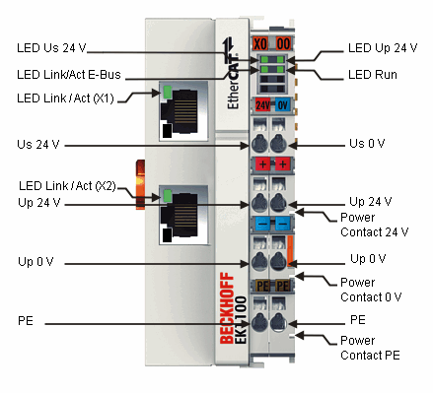
Error Details (LED Light meaning) for the Bus Coupler
EK 1100
https://www.beckhoff.com/english.asp?ethercat/ek1100.htm

Slide 30
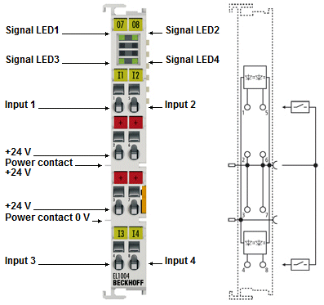
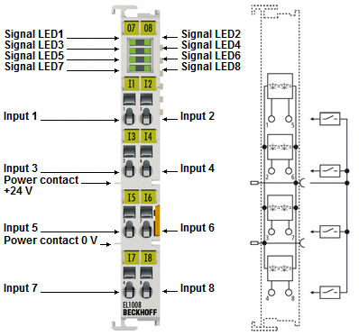
Error Details (LED Light meaning) for the EtherCAT Terminals
EL 1004
EL 1008
https://www.beckhoff.com/english.asp?ethercat/el1004.htm
https://www.beckhoff.com/english.asp?ethercat/el1008.htm

Slide 31
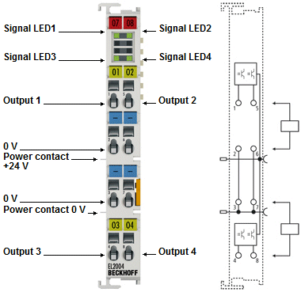
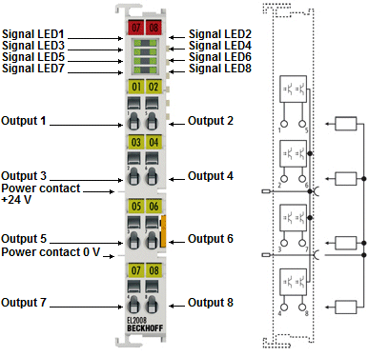
Error Details (LED Light meaning) for the EtherCAT Terminals
EL 2004
EL 2008
https://www.beckhoff.com/english.asp?ethercat/el2004.htm
https://www.beckhoff.com/english.asp?ethercat/el2008.htm

Slide 32
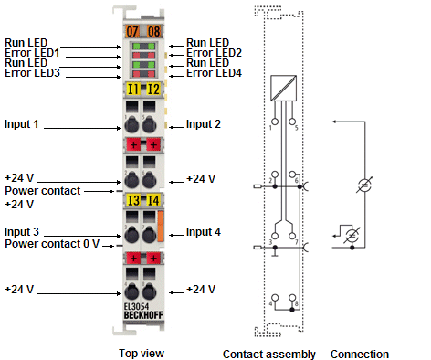
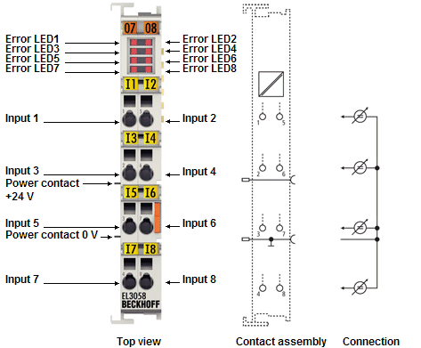
Error Details (LED Light meaning) for the EtherCAT Terminals
EL 3054
EL 3058
An Error LED means that the particular connection/wire is not connected.
https://www.beckhoff.com/english.asp?ethercat/el3054.htm
https://www.beckhoff.com/english.asp?ethercat/el3058.htm

Slide 33
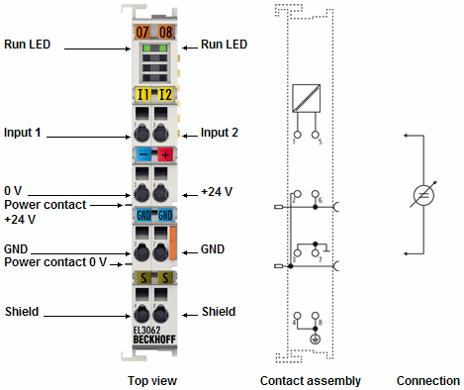
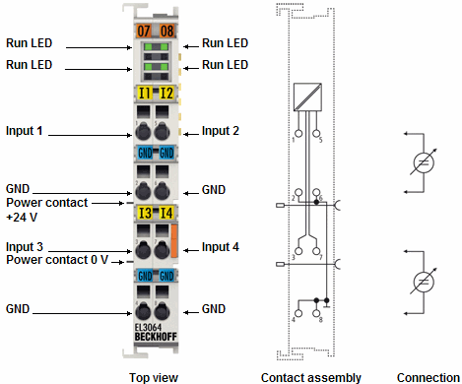
Error Details (LED Light meaning) for the EtherCAT Terminals
EL 3062
EL 3064
https://www.beckhoff.com/english.asp?ethercat/el3062.htm
https://www.beckhoff.com/english.asp?ethercat/el3064.htm

Slide 34
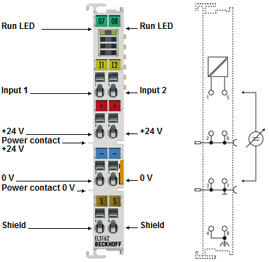
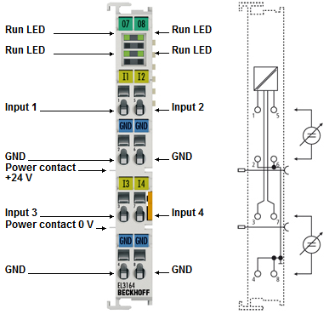
Error Details (LED Light meaning) for the EtherCAT Terminals
EL 3162
EL 3164
https://www.beckhoff.com/english.asp?ethercat/el3162.htm
https://www.beckhoff.com/english.asp?ethercat/el3164.htm

Slide 35
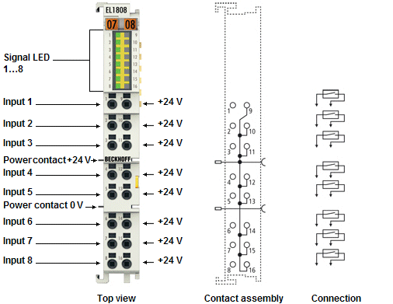
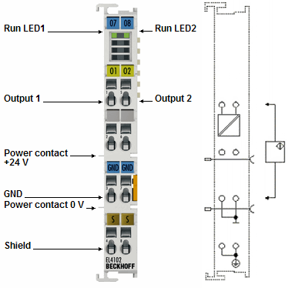
Error Details (LED Light meaning) for the EtherCAT Terminals
EL 1808
EL 4102
https://www.beckhoff.com/english.asp?ethercat/el1808.htm
https://www.beckhoff.com/english.asp?ethercat/el4102.htm

Slide 36
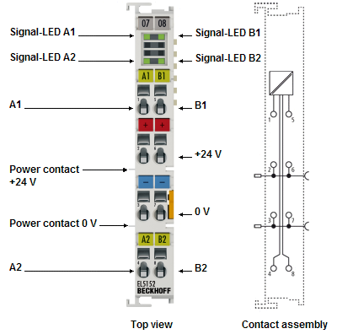
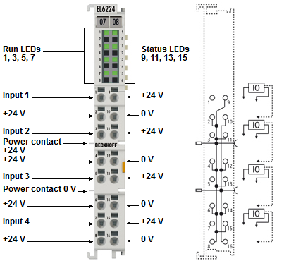
Error Details (LED Light meaning) for the EtherCAT Terminals
EL 5152
EL 6224
https://www.beckhoff.com/english.asp?ethercat/el5152.htm
https://www.beckhoff.com/english.asp?ethercat/el6224.htm

Slide 37

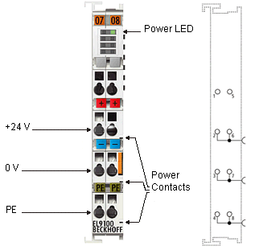
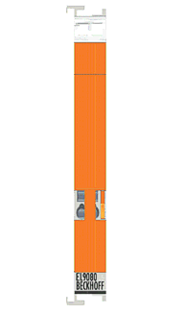
Error Details (LED Light meaning) for the EtherCAT Terminals
EL 9080
EL 9011
EL 9100
https://www.beckhoff.com/english.asp?ethercat/el9080.htm
https://www.beckhoff.com/english.asp?ethercat/el9100.htm
https://www.beckhoff.com/english.asp?ethercat/el9011.htm

